Slide 1
Basics Of LLM
Notes:
Welcome everyone. Today we're going to cover the Basics of Large Language Models — what they are, how they work, and why they matter. Whether you're a developer, a product manager, or just someone curious about AI, this session will give you a solid foundation. We'll start from the history of AI, build up to how LLMs actually work under the hood, and finish with how you can use them effectively right now. Let's get started.

Slide 2
Short History
* During WWII when Alan Turing break code of Nazi Germany using his Enigma Machine, they started thinking of “If a machine can exhibit human-like intelligence”.
In 1950s AI started taking birth, programs that can play checkers and solve equations.
In 1960s rule bases chat bots came which can give answers for any specific questions for which bots are programed.
(Researcher believed that human-like AI is very close.)
In 1980-90s backpropagation & neural networks revived interest; expert systems used in industry.
In 2000s statistical ML surged; SVMs, boosting, and early deep learning emerged.
2017: Google’s “Attention Is All You Need” paper introduced Transformers — the backbone of modern LLMs.
2018-2023: BERT, GPT series, ChatGPT — LLMs entered mainstream use worldwide.
Notes:
AI didn't appear overnight. It began in the 1950s when Alan Turing asked the famous question — can a machine think? Early programs played games and solved equations. In the 60s, rule-based chatbots emerged, but they were rigid — they could only answer what they were explicitly programmed for. The real breakthrough came in the 80s with backpropagation, which taught neural networks to learn from mistakes. Then in 2017, Google published 'Attention Is All You Need' — a paper that changed everything. It introduced Transformers, which are the engine powering every modern LLM you know today, including ChatGPT and Claude.

Slide 3
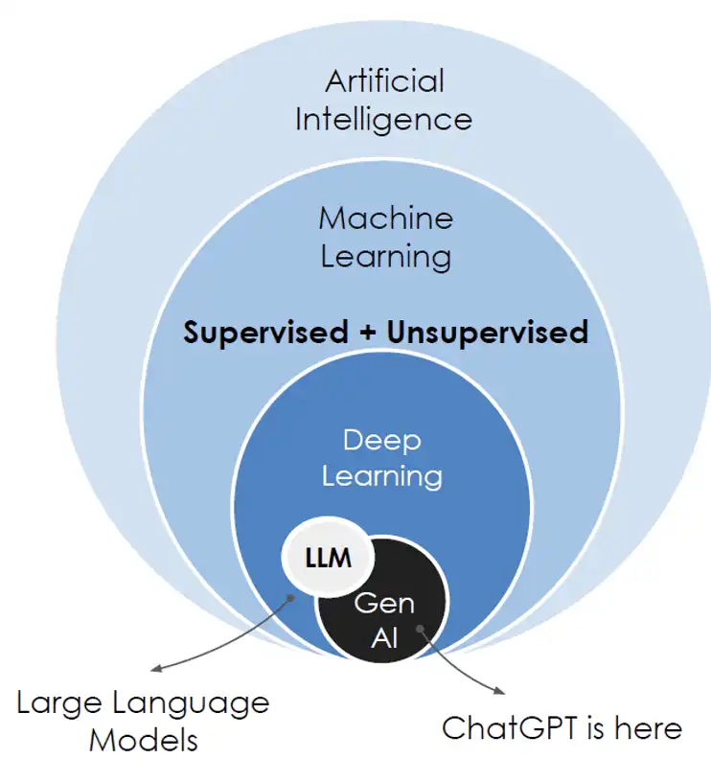
AI Venn Diagram
Notes:
This Venn diagram shows the relationship between AI, Machine Learning, Deep Learning, and LLMs. AI is the broadest term — it includes any technique that makes machines behave intelligently. Machine Learning is a subset where systems learn from data. Deep Learning uses multi-layered neural networks, and LLMs sit inside Deep Learning, specifically focused on language tasks. The key thing to understand is that LLMs are not general AI — they are specialized, powerful tools trained specifically to understand and generate text.

Slide 4
From Machine Learning to AI
1. Machine Learning : System that learn from data instead of hard coded rules.
2. Deep Learning: Uses neural network with many layers.
3. Natural Language Processing (NLP):
- Rule Based System (Grammar Rules)
- Statistical NLP
- Word Embeddings (Word2Vec)
Notes:
So how do machines learn? Machine Learning replaced hand-coded rules with data-driven learning. Give the model enough examples, and it figures out the patterns itself. Deep Learning takes that further with neural networks that mimic the brain — stacked layers that extract increasingly abstract features. Then comes NLP — Natural Language Processing — which is how machines handle human language. It evolved from simple grammar rules, to statistical models, to Word2Vec embeddings where words became mathematical vectors capturing meaning. Each step got us closer to machines that truly understand language.

Slide 5
Contextual NLP
1. RNN - Neural Network Designed for sequential data, but cannot handle large dependencies.
2. LSTM – A special type of RNN designed to overcome RNN limitations.
3. LLMs – Language models that understand and generate human‑like text using large amounts of data and deep learning architectures (primarily Transformers). They capture long‑range context and deliver state‑of‑the‑art performance in most NLP tasks
Notes:
Before Transformers, we had two main approaches to sequential language tasks. RNNs — Recurrent Neural Networks — processed text word by word, but they forgot earlier context in long sentences. LSTMs improved this with memory gates that could remember longer dependencies, but they were slow and still had limits. Then came LLMs powered by Transformers, which solved the long-range dependency problem completely. Instead of reading text sequentially, they look at all words simultaneously and figure out how they relate — which is why they can handle entire documents with full context.

Slide 6
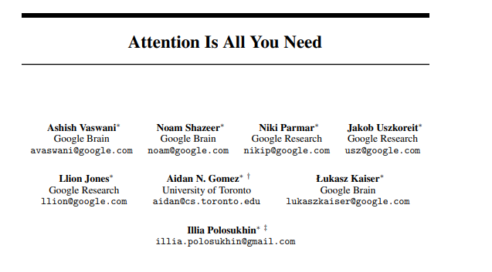
Attention Mechanism
Notes:
This diagram shows the original Transformer architecture from the 2017 Google paper. You can see two main blocks — the Encoder on the left and the Decoder on the right. The Encoder reads and understands the input, the Decoder generates the output. At the heart of both is the Attention mechanism — those 'Multi-Head Attention' boxes. This architecture is what allows the model to understand relationships between words no matter how far apart they are in the text. Most modern LLMs like GPT are Decoder-only models.

Slide 7
Attention Mechanism
What is Attention? A score that tells the model how much to focus on each word when processing another word.
Example: “The cat that was chased by the dog climbed the tree.”
Q (Query): “Who climbed?” — what the model is currently trying to figure out.
K (Key): Every word broadcasts what information it holds — “I am a subject”, “I am a verb”.
V (Value): The actual content to pull in — model attends to “cat” and “climbed” most strongly.
Result: Model correctly understands “cat climbed tree” despite the complex sentence structure.
Notes:
Let me explain Attention with a simple example. Take the sentence: 'The cat that was chased by the dog climbed the tree.' If I ask you who climbed the tree, your brain instantly zooms in on 'cat', 'climbed', and 'tree' — it ignores 'chased', 'dog' and the rest. That selective focus is exactly what Attention does mathematically. Every word gets a score for how relevant it is to every other word. High scores mean pay more attention, low scores mean mostly ignore. This lets the model understand that 'cat' is the subject of 'climbed' even with several words in between. Without Attention, older models would confuse this.

Slide 8
AI Hallucination
What is it? When an LLM confidently generates false or fabricated information — stated as fact.
Cause 1 — Pattern Predictor, Not Fact Checker: LLMs predict the most probable next token, not the most accurate one. Fluency ≠ Truth.
Cause 2 — Training Data Gaps: If the model never saw a fact, it invents a plausible-sounding answer rather than saying “I don’t know.”
Cause 3 — Vague Prompts: Ambiguous questions leave too much room for the model to fill gaps with guesses.
How to Reduce It: Use RAG to ground answers in real documents; write specific prompts; always verify critical outputs.
Notes:
AI Hallucination is one of the most important limitations to understand. An LLM doesn't actually 'know' facts — it predicts the next most likely word based on patterns in training data. So when it doesn't have the right information, instead of saying 'I don't know', it confidently generates something that sounds correct but is completely fabricated. Three main causes: first, the model is optimized to sound fluent, not to be accurate. Second, if the training data had gaps or biases, the model fills those gaps with plausible-sounding guesses. Third, vague or ambiguous prompts leave too much room for the model to improvise. The fix? Always verify important outputs, provide clear prompts, and use RAG to ground the model in real facts.

Slide 9
Better Prompting
1. Be Specific — Eliminate Ambiguity
❌ Vague | ✅ Specific
Write a function to process data. | Write a Python 3.11 function that takes a list of dicts with keys 'id' (int) and 'price' (float), filters out items where price < 0, and returns a new list sorted by price descending.
2. Assign a Role or Persona
❌ No role | ✅ With role
Explain database indexing. | You are a senior database engineer at a high-traffic SaaS company. Explain B-tree vs hash indexing to a backend developer who knows SQL but has never tuned query performance.
Notes:
Prompting is not just asking questions — it is a skill you can improve. First — be specific. Vague prompts get vague answers. Tell the model exactly what you want, in what format, and any constraints. Second — give context. The model knows nothing about your situation unless you tell it. Third — use examples. Showing the model a sample input-output pair is often worth more than a paragraph of instructions. Fourth — ask it to think step by step. This activates the model's reasoning, especially for logic or math problems. Fifth — assign a role. 'You are a senior Java developer' sets the tone and expertise level. Finally — iterate. Treat prompting like a conversation, not a one-shot command.

Slide 10
Better Prompting
3. Provide Context and Constraints
❌ No context | ✅ With context
Why is my API slow? | I have a Node.js 20 + Express API hitting PostgreSQL 15. The /users endpoint takes 2–4s for 500 rows. I already added an index on users.email. Query plan shows a sequential scan on the 'roles' join table. What should I check next?
4. Use Examples (Few-Shot Prompting)
❌ Without example | ✅ With example
Write commit messages for my changes. | Write commit messages in this format:feat(auth): add JWT refresh token rotationfix(api): handle null user in /profile endpointchore(deps): upgrade lodash to 4.17.21Now write one for: added retry logic to the payment service.
Notes:
Prompting is not just asking questions — it is a skill you can improve. First — be specific. Vague prompts get vague answers. Tell the model exactly what you want, in what format, and any constraints. Second — give context. The model knows nothing about your situation unless you tell it. Third — use examples. Showing the model a sample input-output pair is often worth more than a paragraph of instructions. Fourth — ask it to think step by step. This activates the model's reasoning, especially for logic or math problems. Fifth — assign a role. 'You are a senior Java developer' sets the tone and expertise level. Finally — iterate. Treat prompting like a conversation, not a one-shot command.

Slide 11
Better Prompting
5. Iterate — Treat It as a Conversation
Iteration chain:
Turn 1 → "Write a rate limiter in Node.js"
Turn 2 → "Make it use a sliding window algorithm instead of fixed"
Turn 3 → "Add Redis as the backing store"
Turn 4 → "Add unit tests using Jest and mock ioredis"
Notes:
Prompting is not just asking questions — it is a skill you can improve. First — be specific. Vague prompts get vague answers. Tell the model exactly what you want, in what format, and any constraints. Second — give context. The model knows nothing about your situation unless you tell it. Third — use examples. Showing the model a sample input-output pair is often worth more than a paragraph of instructions. Fourth — ask it to think step by step. This activates the model's reasoning, especially for logic or math problems. Fifth — assign a role. 'You are a senior Java developer' sets the tone and expertise level. Finally — iterate. Treat prompting like a conversation, not a one-shot command.

Slide 12
Building Agent
An AI Agent = LLM + Tools + Memory + Goal
Perceive: Agent receives input (user query, tool output, environment state).
Plan: LLM decides what action to take next (ReAct, Chain-of-Thought, or Tree-of-Thought).
Act: Agent calls a tool — web search, code executor, database, API.
Observe: Tool result is fed back into context. Loop repeats until goal is achieved.
Examples: AutoGPT, LangChain Agents, OpenAI Assistants, Claude Projects.
Notes:
An AI Agent takes an LLM and gives it superpowers — tools it can use to take actions in the world. The agent loop works like this: Perceive — the agent receives input, either from you or from a tool result. Plan — the LLM reasons about what to do next. Act — it calls a tool like a web search, a code executor, or an API. Observe — it receives the result and feeds it back into context. This loop repeats until the task is complete. Real-world examples include GitHub Copilot Workspace, which writes and runs code, and customer support agents that can check your order status, process refunds, and escalate to humans — all automatically.

Slide 13
Context Engineering
Context = Everything the LLM “sees” in one request
System Prompt: Instructions, persona, rules — sets the model’s behavior globally.
Conversation History: Prior turns give the model memory of the dialogue.
Retrieved Knowledge (RAG): Relevant docs injected at runtime so model can answer from fresh data.
Tool Results: Outputs from APIs, databases, or code execution fed back into context.
Key Rule: The model only knows what is IN its context window — engineer it carefully.
Notes:
Context Engineering is about what you put into the model's context window — because the model only knows what you give it in that one request. There is no memory between conversations unless you add it. A well-engineered context includes a clear system prompt that sets the rules and persona, the relevant conversation history so the model doesn't lose track, retrieved documents from a knowledge base via RAG so the model can answer from fresh, accurate data, and tool results from previous actions. The key insight is: the quality of your output is directly proportional to the quality of your context. Garbage in, garbage out — this is true for LLMs more than anywhere.

Slide 14
Fine-Tuning & RAG
Making LLMs Domain-Specific
Pre-Training: LLM learns from billions of tokens (internet, books, code). Expensive and done once.
Fine-Tuning: Model re-trained on domain data — makes it expert in medical, legal, or code tasks.
RLHF: Reinforcement Learning from Human Feedback — teaches helpfulness and safety.
RAG (Retrieval-Augmented Generation): Inject relevant docs at runtime. Keeps knowledge fresh without retraining.
When to Use Which: Fine-tune for style/behavior; RAG for up-to-date facts and private data.
Notes:
A pre-trained LLM is like a very well-read generalist — it knows a lot, but isn't specialized. Fine-Tuning changes that by training the model further on domain-specific data — medical records, legal documents, or your company's internal knowledge. The model then speaks the language of that domain with much higher accuracy. RLHF — Reinforcement Learning from Human Feedback — is how models like ChatGPT were made safe and helpful. Human raters scored responses, and the model learned to prefer responses humans liked. RAG is often a better choice than fine-tuning when you need fresh information — instead of baking knowledge into weights, you inject it at runtime. It's cheaper, updatable, and traceable.

Slide 15
Key Takeaways
What You Should Remember
LLMs predict tokens: They don’t “know” things — they predict likely next tokens based on training patterns.
Transformers are the engine: Attention mechanism lets models understand context across long text sequences.
Hallucinations are real: LLMs can confidently produce wrong answers. Always verify critical outputs.
Prompting is a skill: Specificity, role-setting, and examples dramatically improve output quality.
Agents are the future: LLMs + tools + memory = autonomous systems that complete multi-step real-world tasks.
Notes:
Let's wrap up with the five things I want you to walk away with. One — LLMs predict tokens, they don't truly understand. Keep that humility when using them. Two — Transformers and Attention are what make modern LLMs so powerful — they can handle long context and complex relationships. Three — Hallucinations are real and dangerous in high-stakes domains — always verify. Four — Prompting is a skill. Invest time in learning it and you will get dramatically better results. Five — Agents are where this is all heading. LLMs that can perceive, plan, act, and learn from feedback are already here and are becoming more capable every month. Thank you — I am happy to take any questions.

Slide 16
Thank You,
and remember: I take no responsibility for hallucinations during Q&A.

